Slide 1
Select Modifiers
CMPE 2400
Databases

Slide 2
select modifiers
After a query has been constructed that returns a set of records according to the specified columns and filters, situations may arise in which you want to limit the set of acceptable results.

Slide 3
top
The top modifier is used if you only wish to view records that match your “best” or “worst”, “greatest” or “least”, “most recent” or “least recent”, etc. in your raw result set.
  Consider the sales team for a large company. At the end of each month, you may wish to present your “best” salespeople with a bonus.
  Considering the same company, the regions in which the company has experienced the “worst” gross sales may need to be identified for extra advertising.

Slide 4
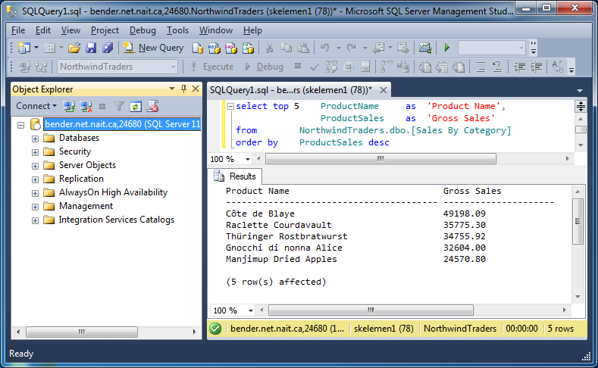
top n
When using the top modifier, you may specify an exact number of records to be returned from the select query, where n is the exact number.

Slide 5
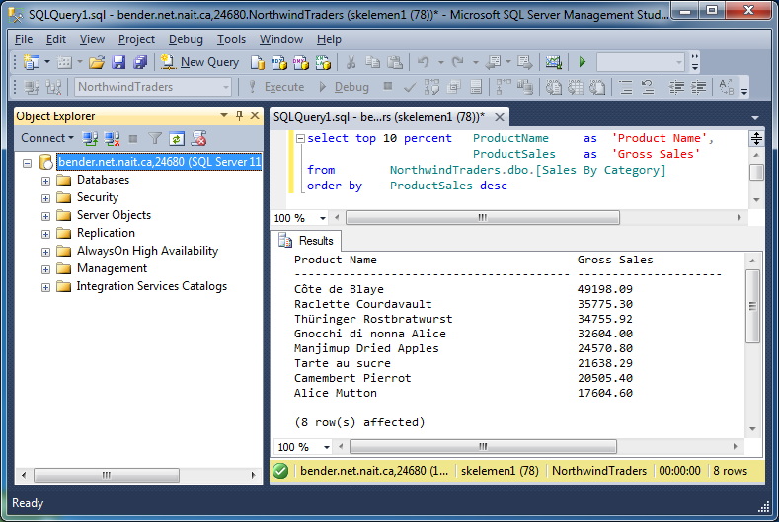
top n percent
Alternately, perhaps the goal will be to retrieve a relative portion of the whole result set rather than a set number of results.

Slide 6
top n [percent] with ties
Situations may arise in which the comparison value of last record to be included in your set according to the used top modifier will be the same for more records than would be included.
  Suppose that a query is to be constructed to return the records from the [Order Details] table in the NorthwindTraders database with the three highest quantities.

Slide 7
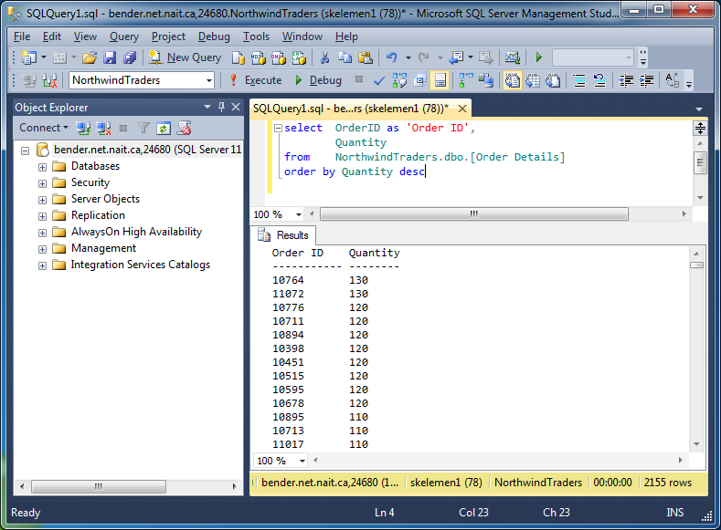
top n [percent] with ties
The following is the unrestricted result set.
  As can be seen below, there are several records that qualify as having the third highest quantity.

Slide 8
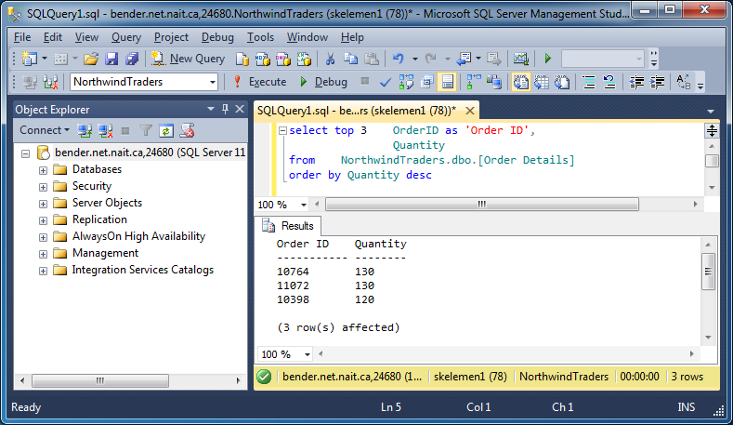
top n [percent] with ties
The database engine will do its best to follow your wishes, yielding the following, inaccurate result set.

Slide 9
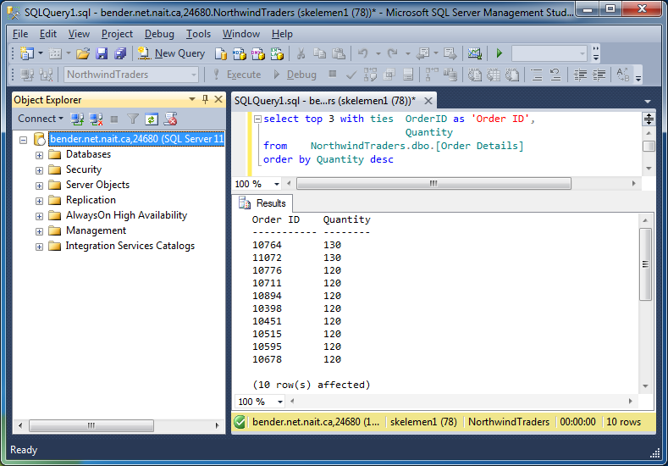
top n [percent] with ties
Adding the with ties clause permits all rows that meet the top 3 requirement to be included.

Slide 10
order by and top
In the queries on the previous slides, it should be noted that the order by clause was always present.
  The reason for this is that you must specify an ordering scheme for your result set if your results are to represent the “most” or “least” of some measureable value.
    If the ordering is left out, then your result set will correspond to the first n records in the unrestricted result set.
    As might be expected, the with ties portion of the modifier will break completely. Try to explain…

Slide 11
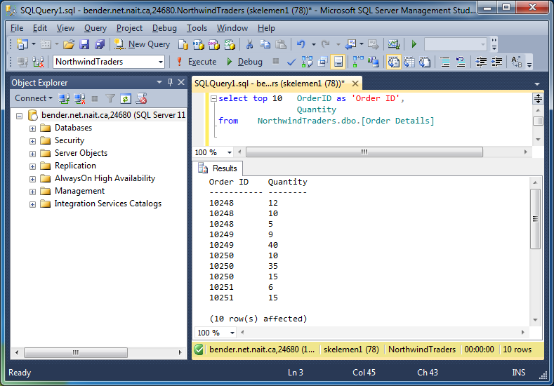
order by and top
The information in the following set is not exactly useful.

Slide 12
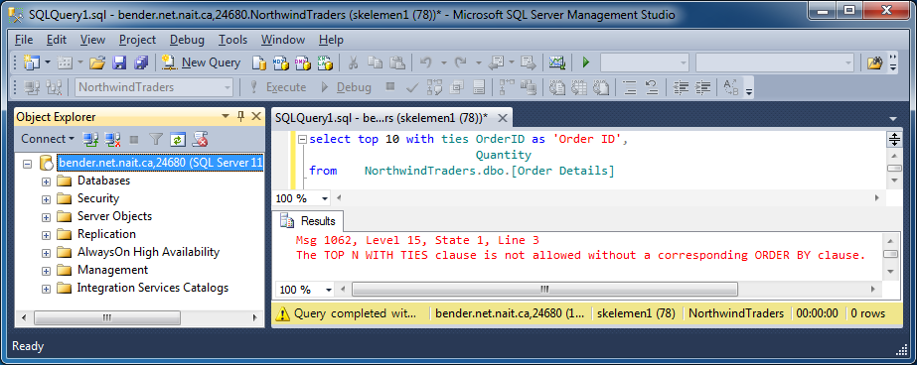
order by and top
Even worse…

Slide 13
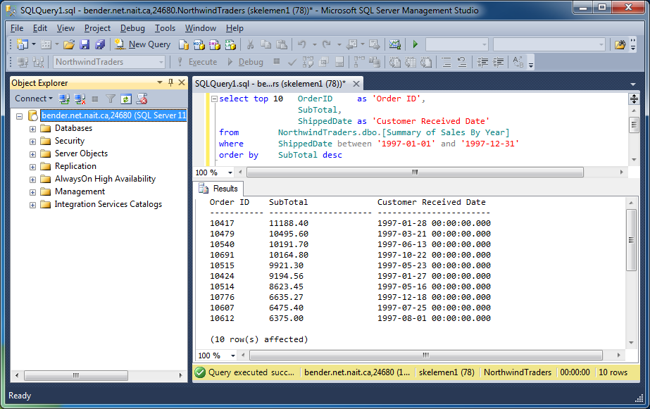
top Example
Be aware that though the where clause has been eliminated from the previous examples, its use is perfectly legal.

Slide 14
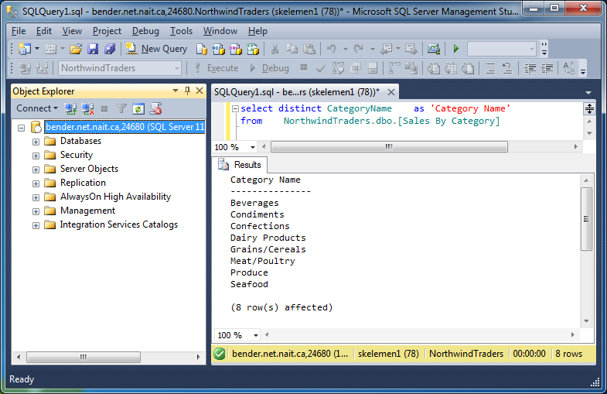
distinct
The distinct modifier removes duplicate data from the returned result set
  This will produce a result set of unique rows

Slide 15
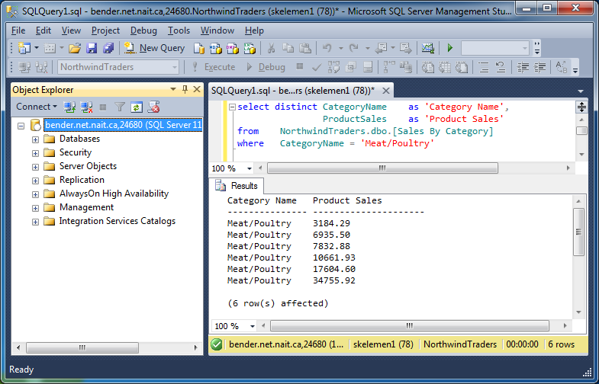
distinct Operator
If multiple columns are specified, then any difference in any column defines uniqueness.

